Slide 1



DIRECT-TO-EMPLOYER PLAN
July 23, 2024

Slide 2


Healthcare Leader in Private Labeled DTE Plans
Louisville, KY
OneHealth Plan
Cincinnati, OH
TCH Optimal
Bentonville, AR
Northwest Health Plan
Knoxville, TN
East Tennessee Health Plan
Meridian, MS
Affinity Health Plan
Fort Myers, FL
Lee Health Care Partners

Slide 3

Direct-to-Employer (DTE) Your plan focused on Your relationship with Employers
YOU Pick the Name of the Health Plan
YOU Determine the Fees Charged
YOU Practice the Medicine
YOU Receive the Profits
WE Make it Successful

Slide 4



Direct-to-Employer Strategy: Increased Capture of Commercial Market Share
BH DTE
PPO #1
PPO #2
PPO #3

Slide 5
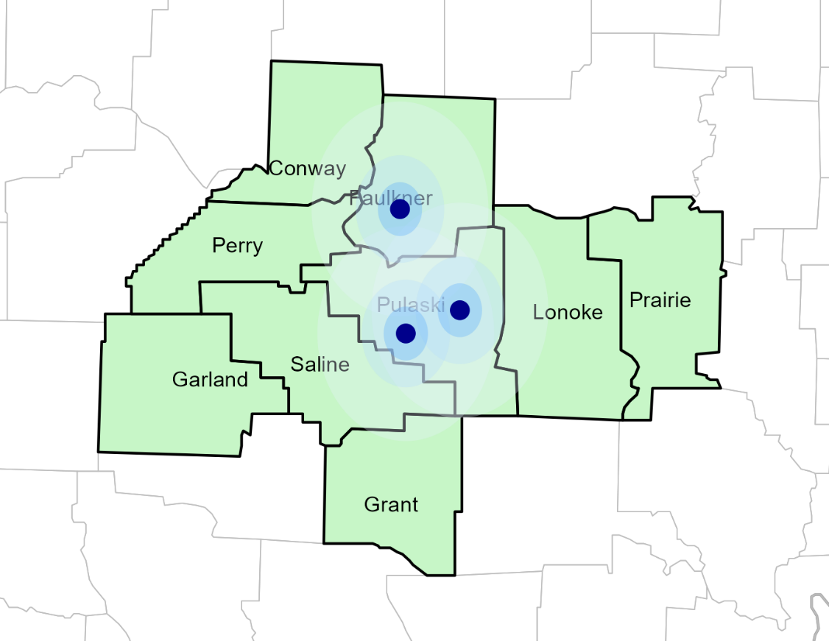
Significant Opportunity for Baptist Health
Target Market 1,073 Employers 120,000+ Employees 190,000+ Members
 | Total Employees
Commercial Employers With Headquarters: | 50-100 | 101-200 | 201-400 | 401-1000 | 1001-3000 | 3000+
Within 10 Miles of a BBH Hospital | 427 | 179 | 125 | 67 | 26 | 15
Within 11-20 Miles of a BBH Hospital | 145 | 48 | 31 | 21 | 4 | 1
Within 21-30 Miles of a BBH Hospital | 56 | 23 | 13 | 11 | 2 | 0
Employees at Above Firms | 50-100 | 101-200 | 201-400 | 401-1000 | 1001-3000 | 3000+
Within 10 Miles of a BBH Hospital | 32,025 | 26,850 | 37,500 | 46,900 | 52,000 | 165000
Within 11-20 Miles of a BBH Hospital | 10,875 | 7,200 | 9,300 | 14,700 | 8,000 | 11000
Within 21-30 Miles of a BBH Hospital | 4,200 | 3,450 | 3,900 | 7,700 | 4,000 | 0
Total Members at Firms | 50-100 | 101-200 | 201-400 | 401-1000 | 1001-3000 | 3000+
Within 10 Miles of a BBH Hospital | 51,240 | 42,960 | 60,000 | 75,040 | 83,200 | 264,000
Within 11-20 Miles of a BBH Hospital | 17,400 | 11,520 | 14,880 | 23,520 | 12,800 | 17,600
Within 21-30 Miles of a BBH Hospital | 6,720 | 5,520 | 6,240 | 12,320 | 6,400 | 0

Slide 6
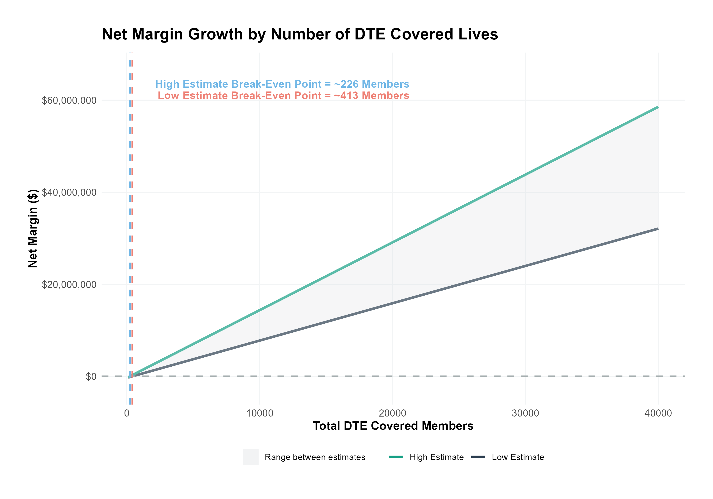
Core Model Assumptions
Commercial care margin is 26% (conservatively 70% of observed margin)
DTE pricing is 5% below current commercial levels (employers pay ~10% less but SLUHN saves with easier billing)
Estimated 38% inpatient market share
Estimated 23% outpatient market share
SINGLE-YEAR PROJECTION

Slide 7
SINGLE YEAR SUMMARY
DTE Covered Members Financial Analysis | DTE Covered Members Financial Analysis | DTE Covered Members Financial Analysis | DTE Covered Members Financial Analysis | DTE Covered Members Financial Analysis | DTE Covered Members Financial Analysis | DTE Covered Members Financial Analysis | DTE Covered Members Financial Analysis
Low (conservative) estimate. All monetary values in thousands of dollars | Low (conservative) estimate. All monetary values in thousands of dollars | Low (conservative) estimate. All monetary values in thousands of dollars | Low (conservative) estimate. All monetary values in thousands of dollars | Low (conservative) estimate. All monetary values in thousands of dollars | Low (conservative) estimate. All monetary values in thousands of dollars | Low (conservative) estimate. All monetary values in thousands of dollars | Low (conservative) estimate. All monetary values in thousands of dollars
DTE Members | Pre-DTE Revenue | Pre-DTE Margin | DTE Revenue | DTE Incr. Revenue | DTE Total Margin | DTE Incr. Margin | Net Margin Less DTE Fees
100 | $ 521K | $ 134K | $ 1,033K | $ 512K | $ 214K | $ 80K | $ -249K
500 | $ 2,603K | $ 668K | $ 5,165K | $ 2,562K | $ 1,068K | $ 399K | $ 75K
1,000 | $ 5,207K | $ 1,337K | $ 10,331K | $ 5,124K | $ 2,136K | $ 799K | $ 481K
2,500 | $ 13,017K | $ 3,342K | $ 25,827K | $ 12,811K | $ 5,339K | $ 1,997K | $ 1,697K
10,000 | $ 52,067K | $13,367K | $103,309K | $ 51,243K | $21,357K | $ 7,990K | $ 7,780K
20,000 | $104,133K | $26,734K | $206,618K | $102,485K | $42,714K | $15,980K | $15,890K
 | Note: DTE = Direct-to-Employer | Note: DTE = Direct-to-Employer | Note: DTE = Direct-to-Employer | Note: DTE = Direct-to-Employer | Note: DTE = Direct-to-Employer | Note: DTE = Direct-to-Employer | Note: DTE = Direct-to-Employer
NOTE: Please see detailed financial analysis and assumptions used starting on page 34.
Financial projections do not include 340B contribution margin, which could represent $136 pmpm based upon optimizing 340B through plan design, SLUHN’s approved site(s) with network integration, and development of SLUHN’s proprietary PBM program.

Slide 8



Founded in 1979 and headquartered in Indianapolis, IN​
Full-service TPA specializing in the administration of self-funded health plans and population health management​
One of the country’s largest independently-owned TPAs
The Key Family is a commonly-held group of benefits related organizations with:​
3,000+ corporate clients​
3.0 million members under management​
Exclusive Relationship
We know The Market – Agents, Networks, and MGAs

Slide 9





A Partner You Can Trust
OUR OBJECTIVES ARE ALIGNED
WE KNOW THE
MARKET
COMPLETELY TRANSPARENT
WE HAVE THE SOPHISTICATION AND INFRASTRUCTURE TO EFFECTIVELY COMPETE
Jack Hill, Executive Vice President – KBA
630-878-7539 * jack.hill@keybenefit.com

